Slide 1
Personalized Advertisement
System
CS633

Slide 2

Overview
Role of Team
Policy
Scope

Slide 3

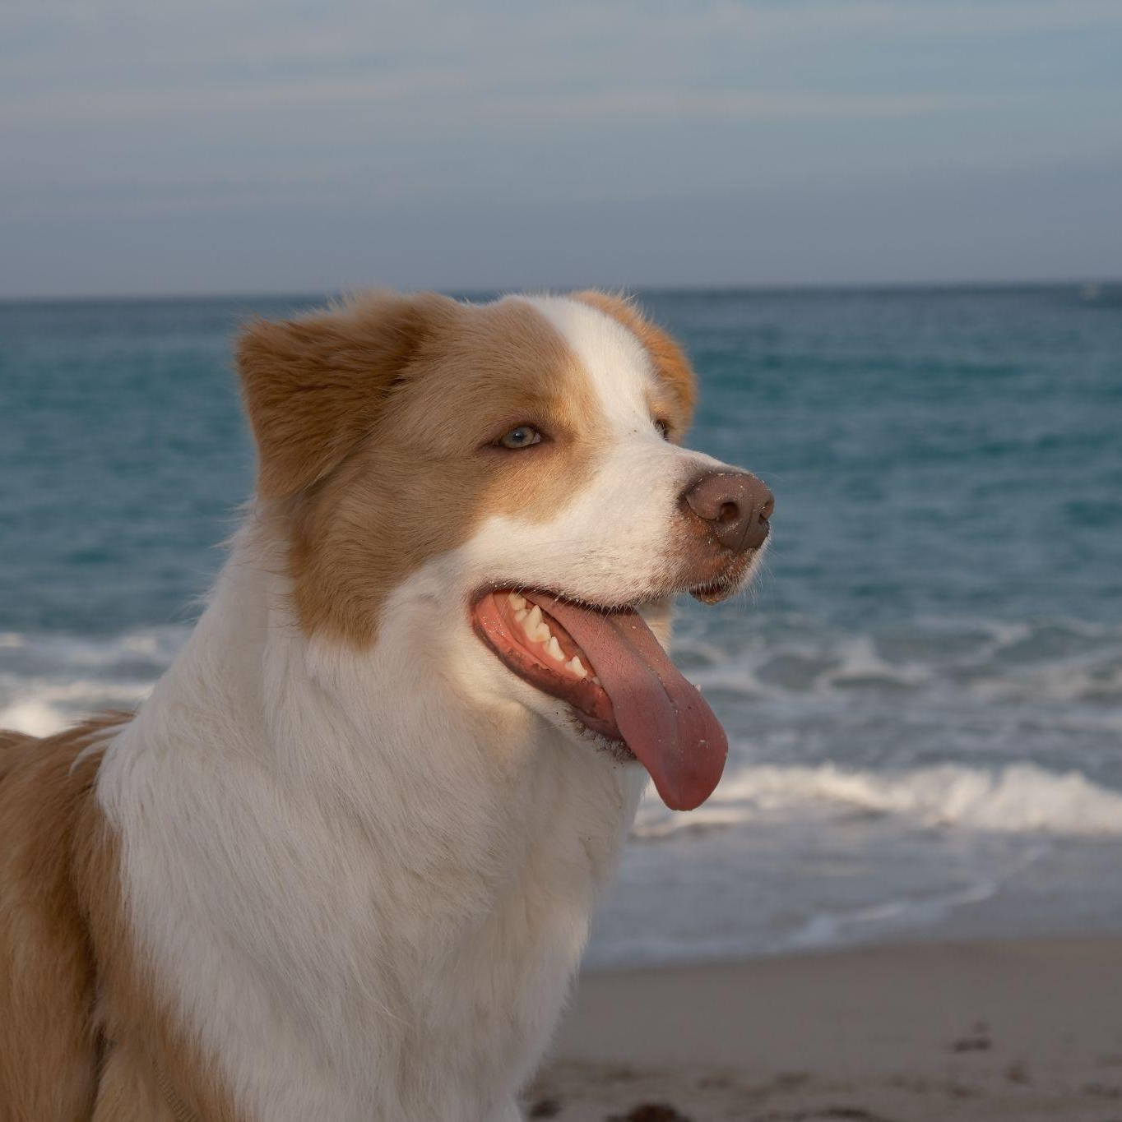

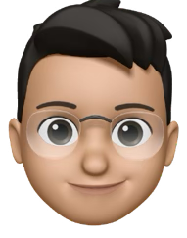
Roles of our Team Members
Rouling Wang
Yidong Yao
Shreya Rana
Lei Zhu
Tester
Team Leader
Front-End Developer
Back-End Developer

Slide 4
Policy
Meeting Time​​
Attendance Policy
Every Friday around 9 pm on zoom or Whatsapp(can be modified, depends on team member’s schedule).
The attendance policy is mandatory unless an emergency or prior commitment arises.
Tools​​
Pivotal Tracker, GitHub, Zoom, Whatsapp, Google Doc, Google Slide, VS Code.
Grading Policy
Team members will receive the same grade until the professor communicates any changes.

Slide 5
Scope
The project aims to develop a "Personalized Advertisement System" that tailors advertisements to individual users based on their preferences, browsing history, and behavior. The system will utilize data analytics and machine learning to improve ad targeting, increasing the relevance and effectiveness of advertisements. Key components of the project include:
Data Collection: Gather user data, including browsing patterns, purchase history, and other relevant metrics.
Ad Personalization Algorithm: Develop an algorithm to analyze the collected data and generate personalized ads.
Frontend Interface: Create a user-friendly interface for displaying ads that integrate seamlessly with the website or application.
Backend Development: Implement a robust backend to handle data processing, storage, and interaction with the ad personalization algorithm.
Testing and Optimization: Conduct extensive testing to ensure the accuracy and relevance of ads, followed by continuous optimization based on user feedback.

Slide 6
Persona
Jessica works for a medium-sized e-commerce company that sells beauty and skincare products. She has a strong background in digital marketing and is always looking for ways to improve customer engagement and conversion rates.
Jessica Chen
28
Digital Marketing Manager

Slide 7
Persona
David runs an online store that specializes in selling gadgets and tech accessories. He is highly data-driven and focuses on optimizing his sales funnel to increase conversion rates. David values technology that can help him make data-backed decisions to grow his business.
David Lee
35
E-commerce Entrepreneur

Slide 8
Persona
Lisa is a lifestyle and fashion influencer with a large following on Instagram and YouTube. She frequently collaborates with brands to promote their products. Lisa wants to provide her audience with ads that are genuinely relevant to their interests and preferences to maintain her authenticity.
Lisa Nguyen
24
Social Media Influencer

